Slide 1
Azure and Office 365 DevCamp – Developer Tools

Slide 2
Agenda
Developer Environments
Tools
Language Specific SDKs

Slide 3
Developer Environment Options
Local
Windows
Linux/OSX
Cloud
Developer images

Slide 4
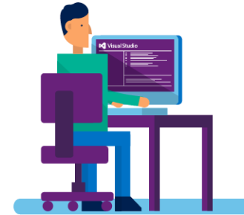
A Suite of Azure Developer Tools and SDKs
Visual Studio 2015, “15” and 2013
App Services
Connected Services
WebJobs
PowerShell Editing
Debugging
Integrated DevOps
Azure SDK for .NET
Cloud Services
Azure Resource Manager (ARM, IaaS VMs)
Azure Resource Optics via Cloud Explorer
Diagnostics for Cloud Services, VMs and VMSS
Data Factory Tools
Visual Studio Tools for Docker – Preview
Azure Service Fabric Tools for Visual Studio
Language SDKs
Azure SDK for Java
Azure SDK for Node.js
Azure SDK for Python
Azure SDK for Ruby
Azure SDK for PHP
Azure SDK for Go
Command-Line Tools
Azure Command-Line Interface
Azure PowerShell
Standalone Tools
Visual Studio Code and extensions (ARM, ASP.NET Core)
Microsoft Azure Storage Explorer
Azure Toolkit for Eclipse and IntelliJ
Docker Tools (Visual Studio Code, Visual Studio Team Services, and Yeoman Generator for Docker)
Azure DevTest Labs
Java
PHP
Data
App
Notes:
We release a lot of different tools to help you develop apps for Azure.
There is a lot you can do, without having to leave Visual Studio:
restart servers in Azure directly from Visual Studio
debug you web application or Service Fabric services running in Azure, directly from Visual Studio.
configure diagnostics settings on your cloud services from Visual Studio.
even create new resources, like VMs, web apps and storage account for your applications.
We even provide local-only emulators and
When you need to interact with Azure services in your applications, you are almost certain to find the programming language you use among our SDKs.
If you are more to CLI and PowerShell, we have great support for that as well.
We also so have standalone tools like Storage Explorer to help you.

Slide 5





Dev Box in the Cloud

Slide 6
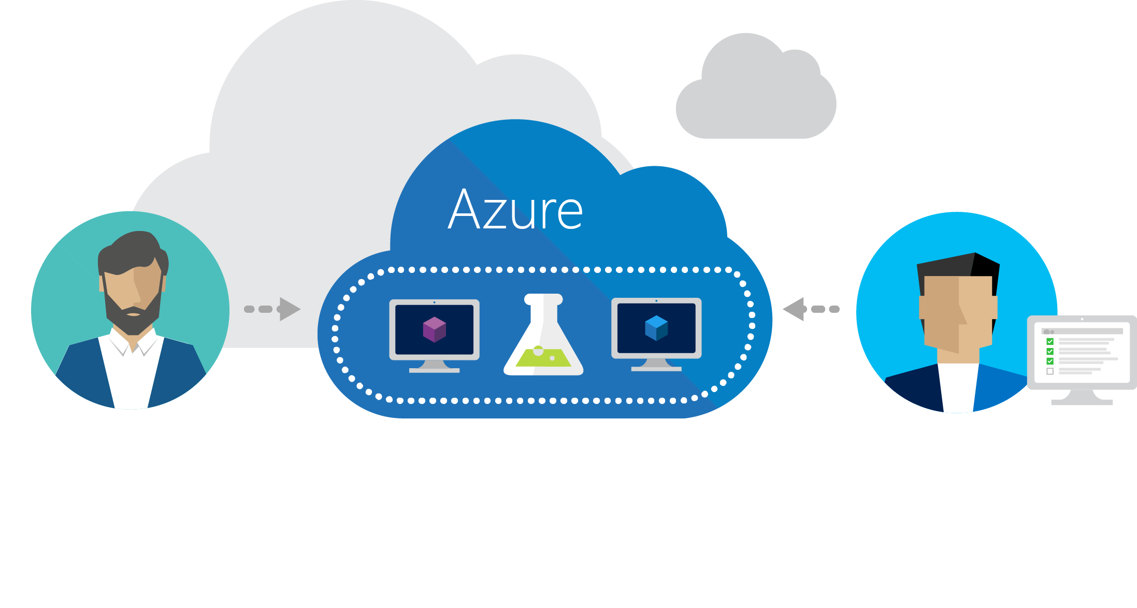
Azure DevTest Labs
Try at http://aka.ms/dtl
Fast, easy, and lean dev-test environments in Azure.
Specifically for your team.
On demand.

Slide 7


Dev-test in the cloud: drivers and concerns
Drivers
Concerns
Agility
Integration
Economics
Security
IT admin
Scale
Compliance
Speed
Performance

Slide 8


Challenges of running dev-test on premises
Your datacenter
IT admin
VMs in dev-test environment
Developers
Provision VMs
Request VMs
65%
of developers say it is too complicated and time-consuming to get development and test resources
Your challenges
Compromised agility
Limited hardware budget
Limited software licensing
Resource contention with VMs
Realistic scale tests often challenging
Procurement delays
10%
Average utilization of dedicated dev-test infrastructure
Source: Business Case for Test Environment Management Whitepaper, Cognizant

Slide 9
Azure DevTest Labs
Fast, easy, and lean dev-test environments in Azure.
Specifically for your team. On demand.

Slide 10
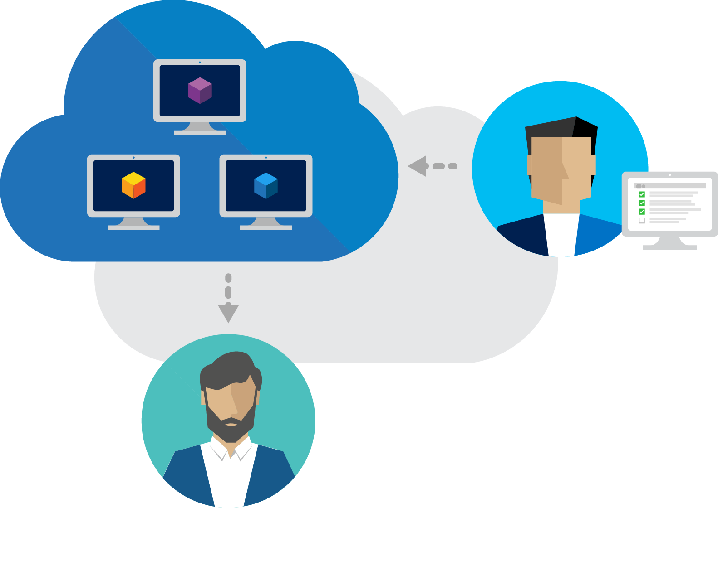
Worry-free self-service
Fast provisioning
Share Templates
Integrate with your toolchain

Slide 11
Tools

Slide 12
Azure Tools
https://azure.com/tools https://www.visualstudio.com/vs/azure-tools
Notes:
Before you leave:
Remember how you can build great applications, using our suite of open and flexible tools and unlock the possibilities the cloud has brought to us.
By now you should be well aware, that we have tools available that fit’s your needs and across tasks, roles and preference of OS.
Make sure to use the tools you know and love
get what you need at this website
sign-up for your Azure benefits and start building cloud apps today

Slide 13
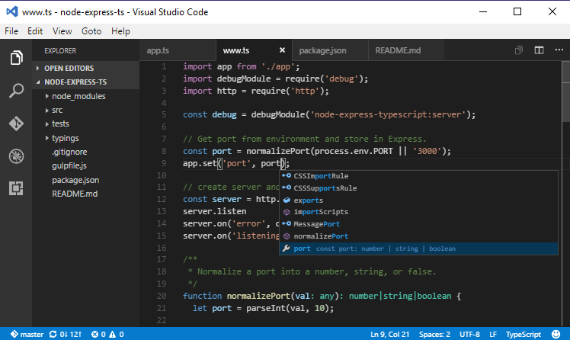
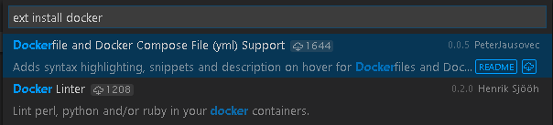
Visual Studio Code
Cross-Platform
Windows, Linux, and Mac too!
Built-in Highlighting
Dockerfile
Docker-Compose
VS Code & Docker
https://code.visualstudio.com/Docs/languages/dockerfile

Slide 14
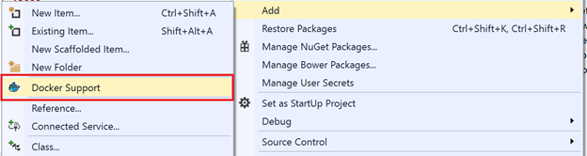
Docker Tools for Visual Studio 2015 (Preview)
https://aka.ms/DockerToolsForVS
Adds Dockerfile & scripts to project
Deploy & debug in containers

Slide 15
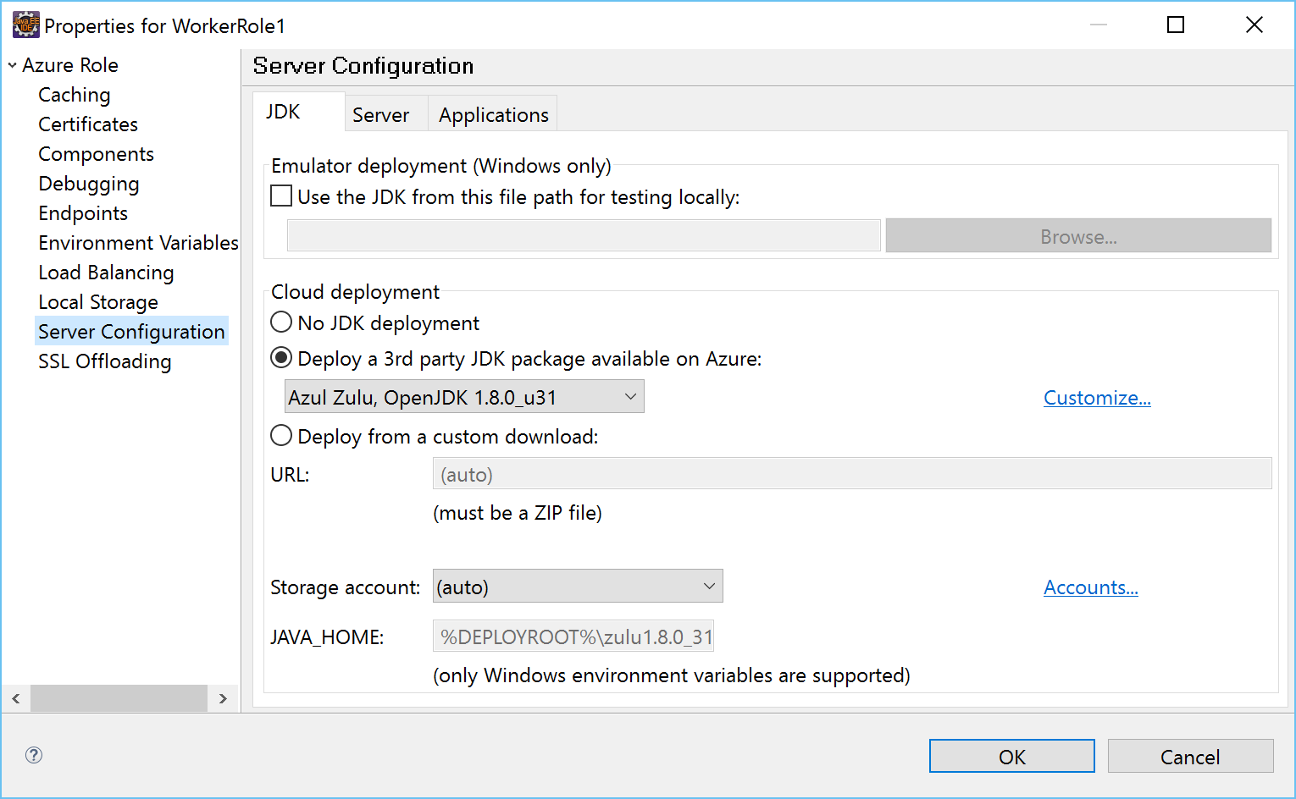
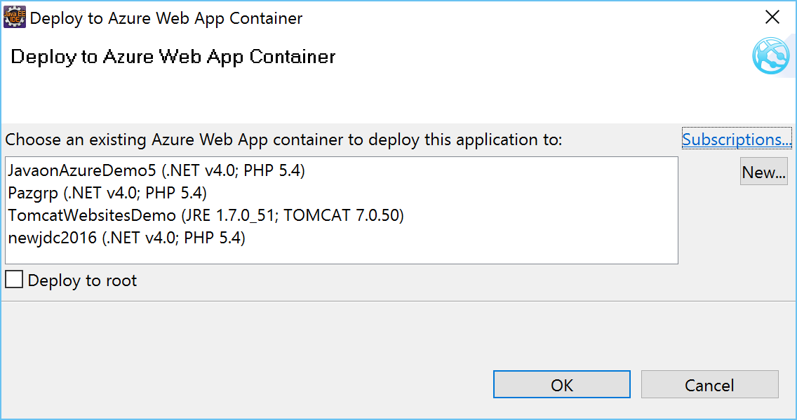
Azure Toolkit for Eclipse/for IntelliJ
Deploy to Azure Web Apps or Azure PaaS

Slide 16
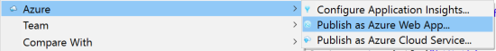
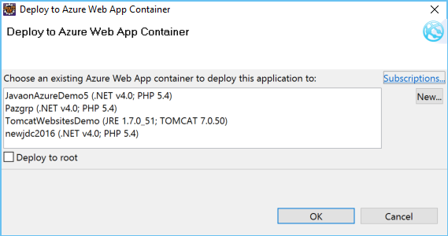
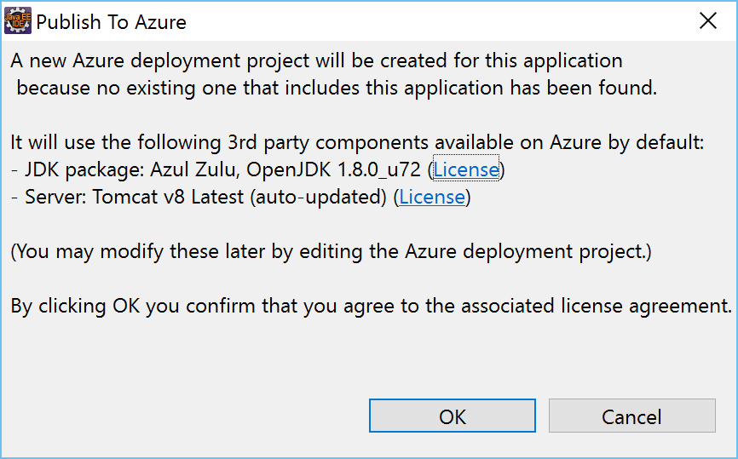
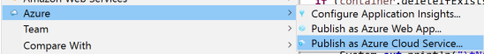
Azure Toolkit for Eclipse/for IntelliJ

Slide 17
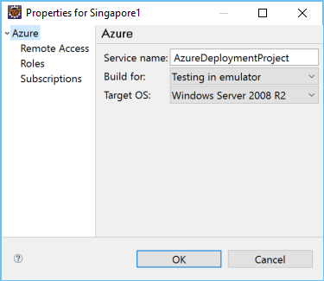
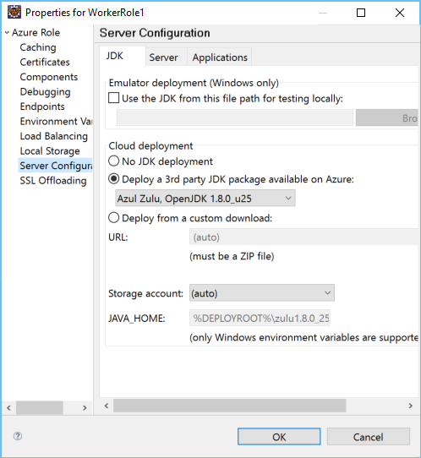
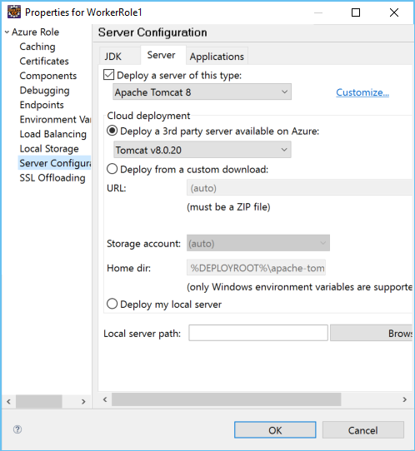
Azure Toolkit for Eclipse/for IntelliJ

Slide 18
SDK’s

Slide 19


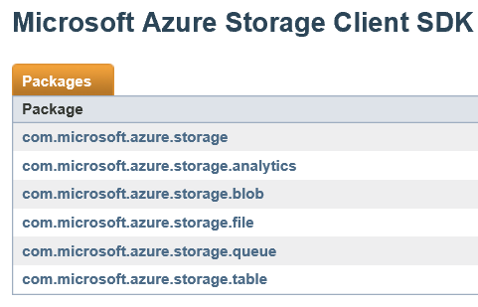
Your OS, frameworks, and data sources
We Use Java
1 in 3 Linux VMs
Popular on Azure
Azure is the only Oracle-certified cloud platform
HDInsight (Hadoop), Azure Search (Elastic Search)
Javadoc views on Azure are 2nd (after .NET)
MICROSOFT CONFIDENTIAL

Slide 20
.NET

Slide 21
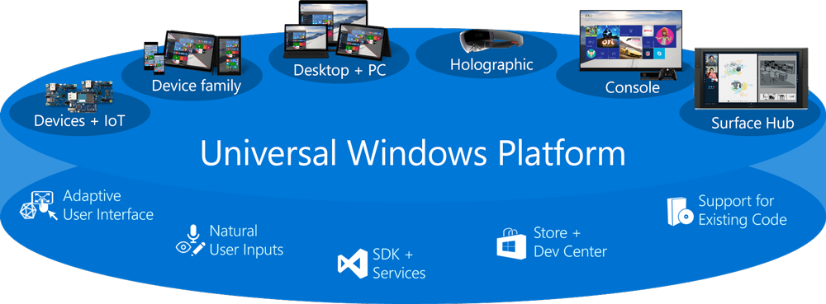
Windows 10 and UWP

Slide 22
.NET today
Platform for .NET applications on Windows
.NET Framework
Cross-platform and open source framework optimized for modern app needs and developer workflows
.NET Core
Cross-platform and open source Mono-based runtime for iOS, OSX, and Android devices
Xamarin
Distributed with Windows
Distributed with app
Distributed with app

Slide 23
Visual Studio

Slide 24
Java + Azure

Slide 25
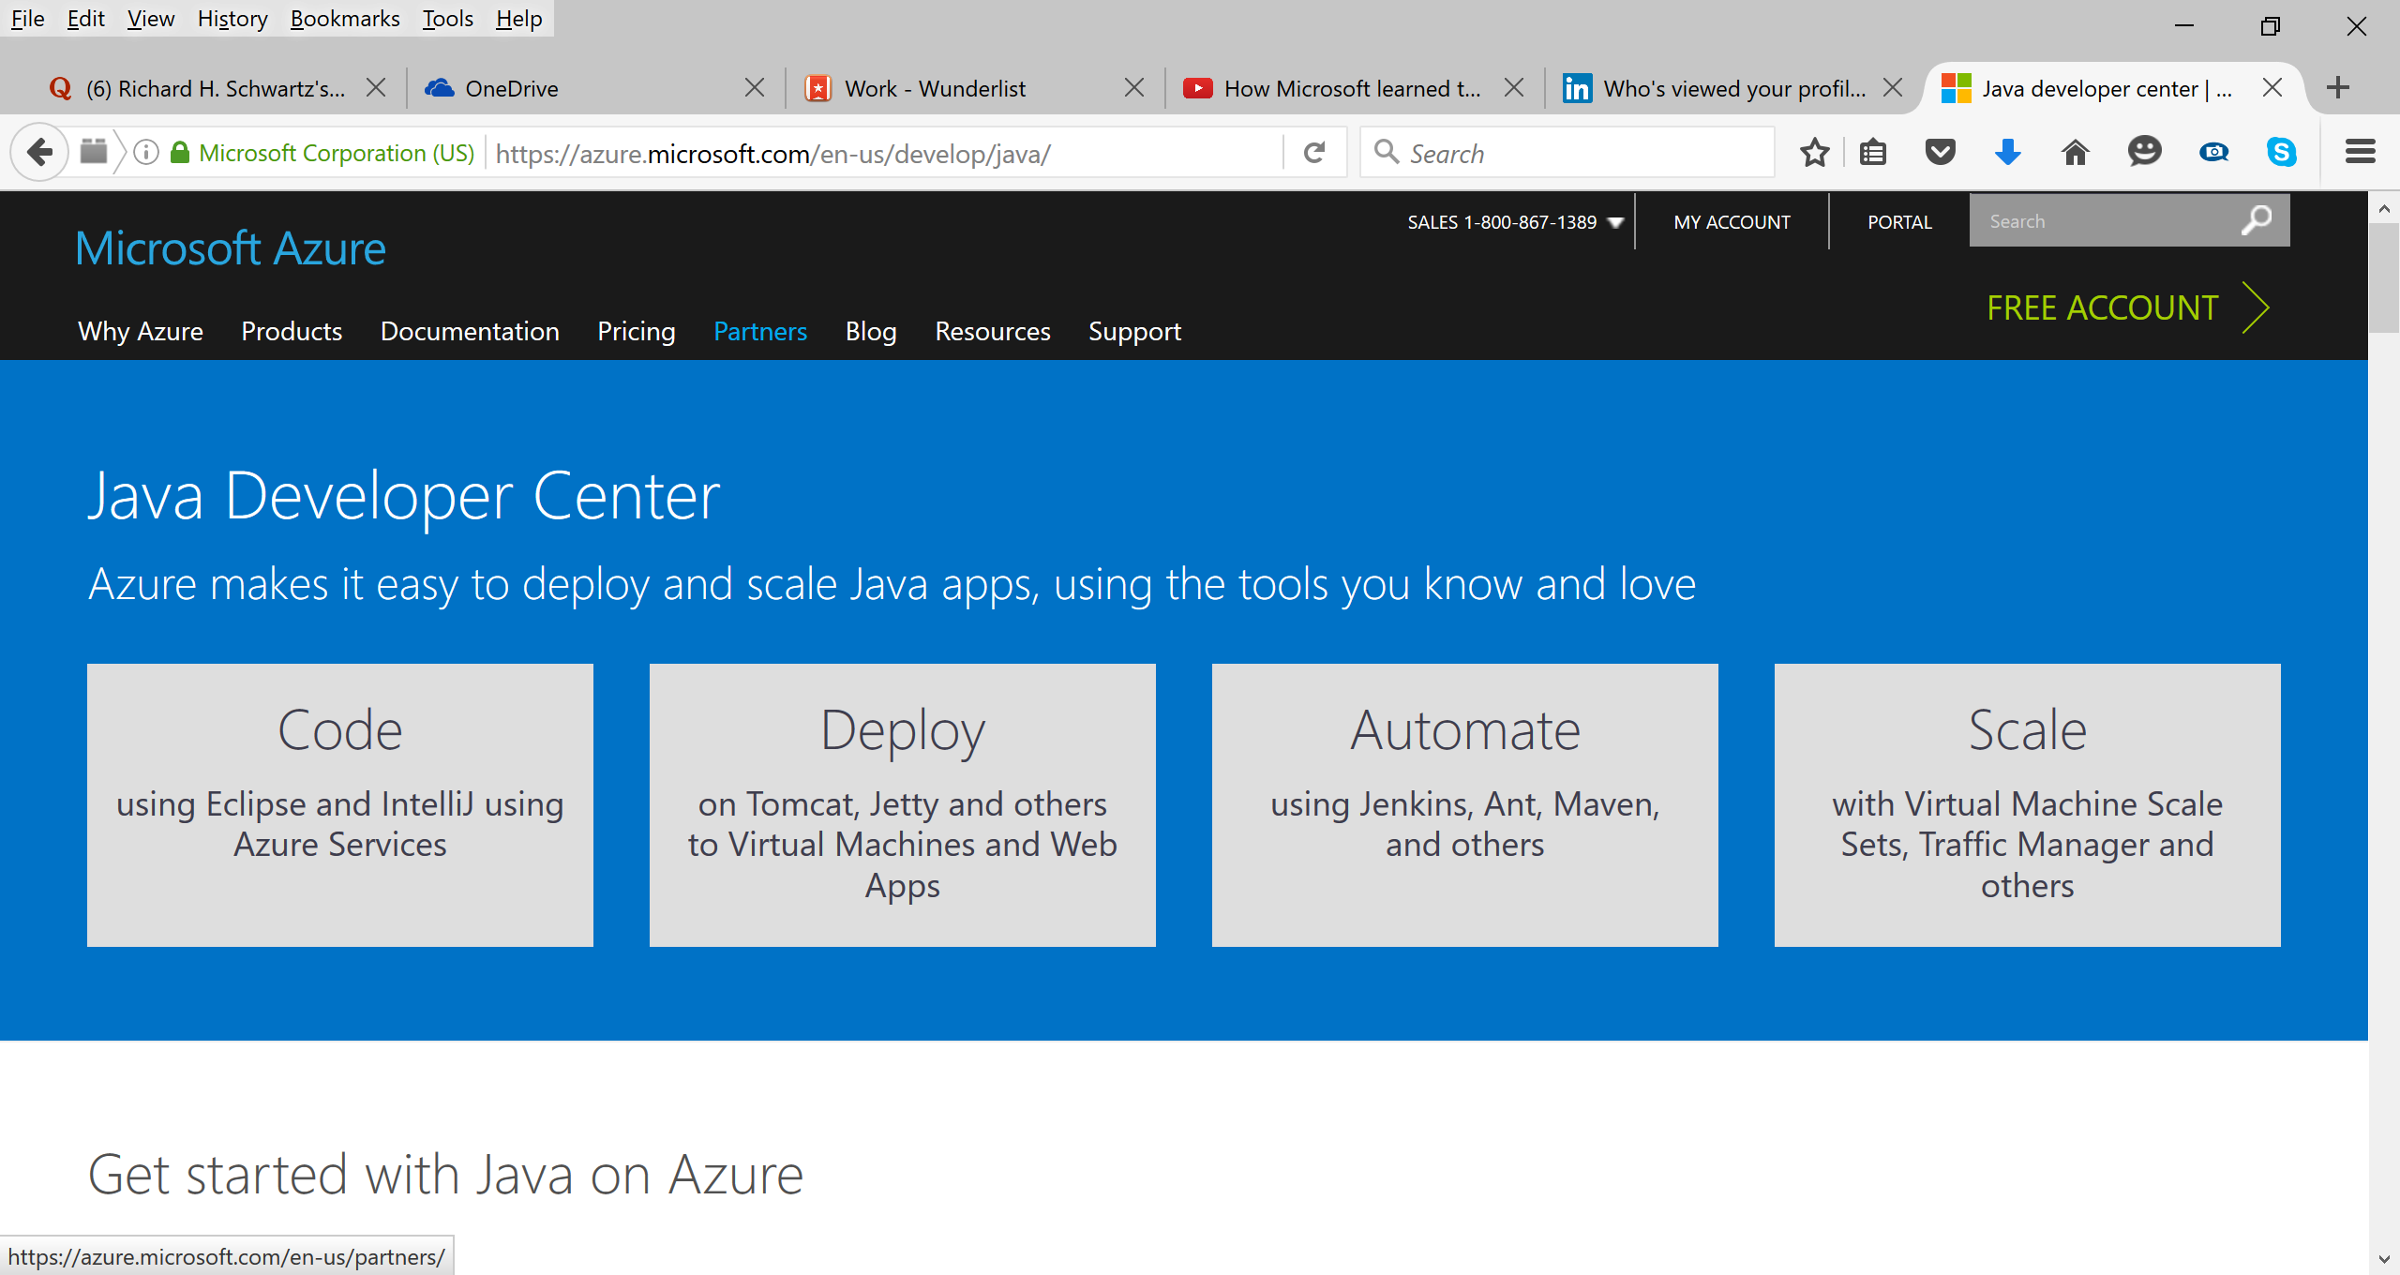
Java Dev Center – azure.com/java

Slide 26
Java deployment in Azure
IaaS
PaaS
Virtual Machines
VM Extensions
+ Containers
VM ScaleSets
Cloud Foundry,
Container Services
Service Fabric
Bring your Java
Automate everything
Elastic Declarative
Stateless & Stateful
Ultimate
Control
Cost &
Agility

Slide 27
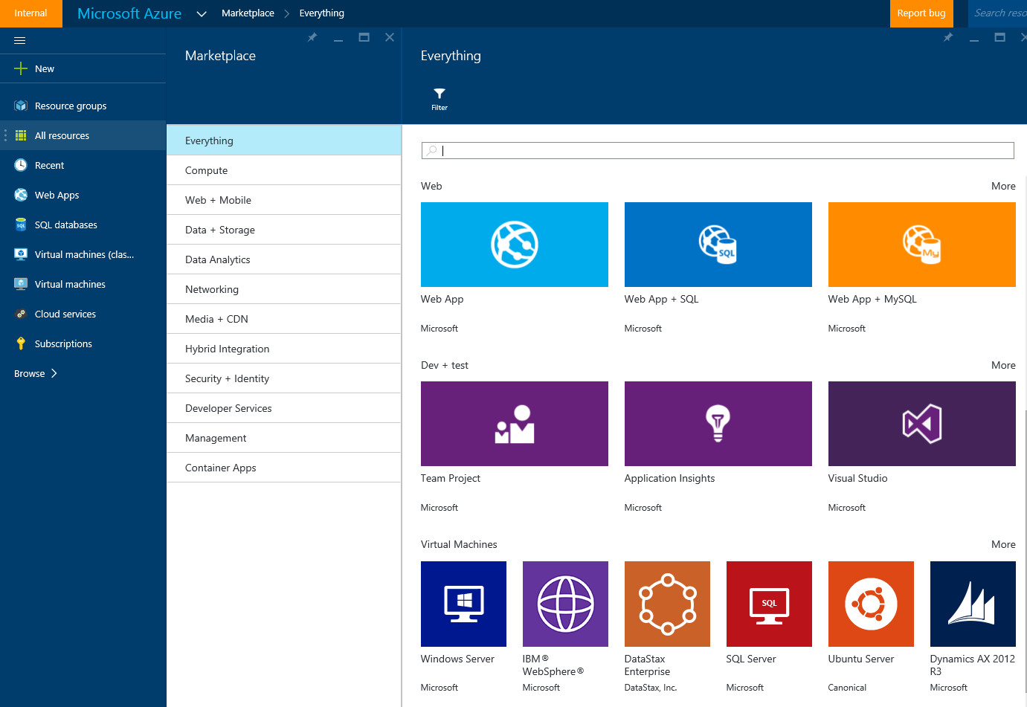
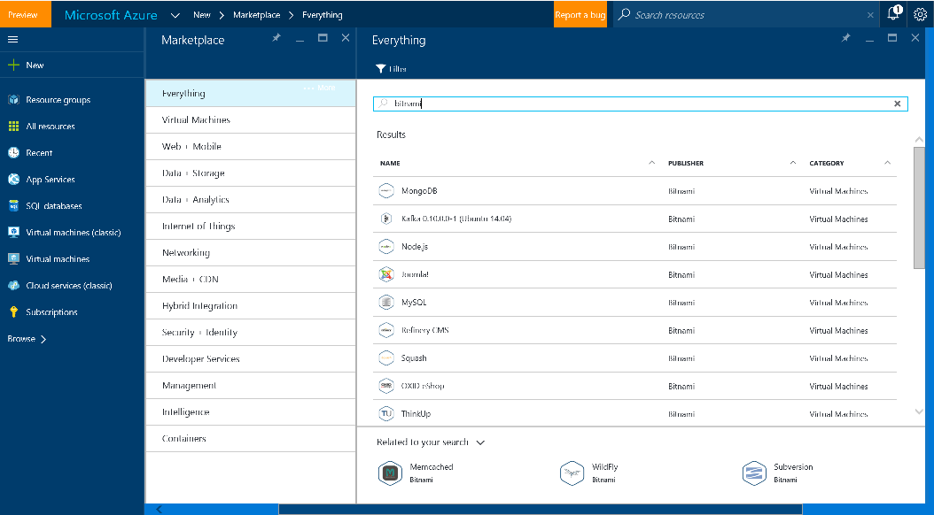

VMs – Many ways to get started
Marketplace
Community
BYOI

Slide 28
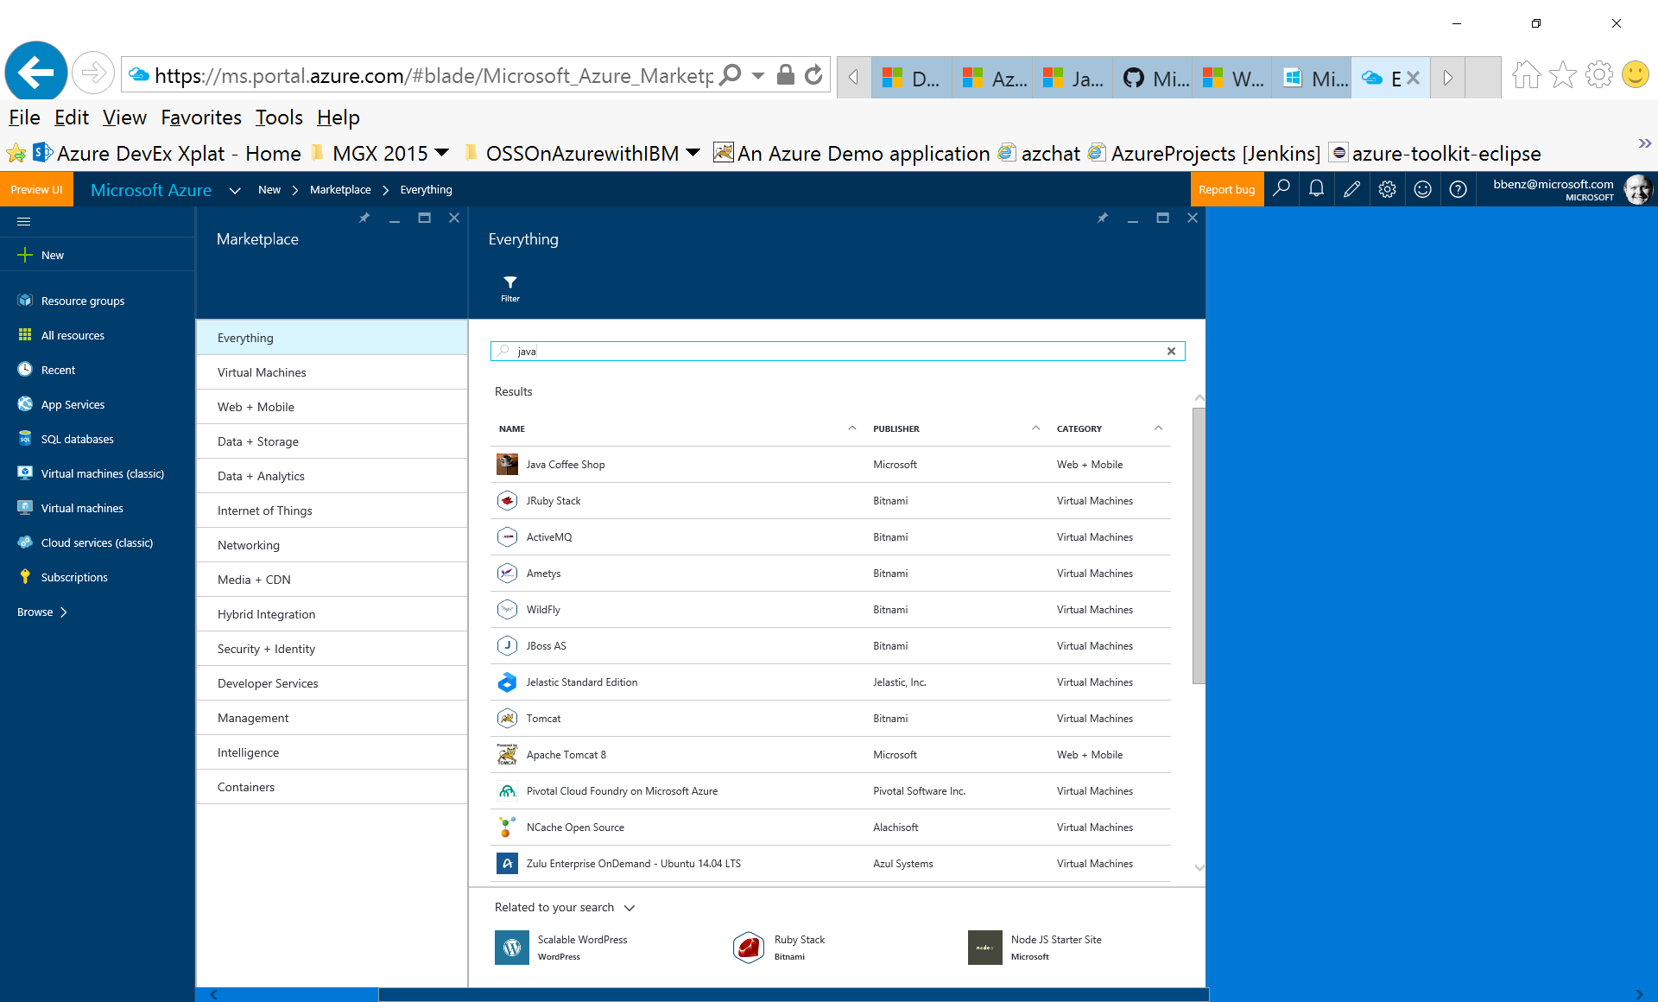
Marketplace – Accelerate getting started

Slide 29
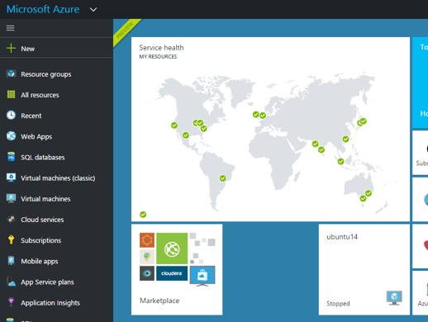
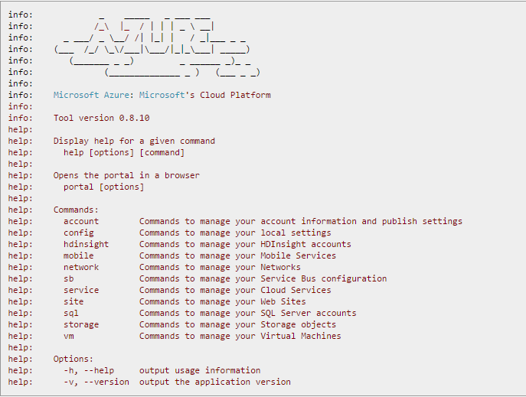
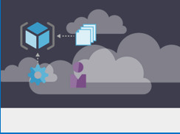
Provisioning
Azure Portal
Azure CLI
ARM Templates
MICROSOFT CONFIDENTIAL

Slide 30
Azure Resource Manager
Azure Templates can:
Ensure Idempotency
Simplify Orchestration
Simplify Roll-back
Provide Cross-Resource Configuration and Update Support
Azure Templates are:
Source file, can be checked-in
Specifies resources and dependencies (VMs, WebApps, DBs) and connections (config, LB sets)
Support parametized input/output.
Open to community for contribution
My App
Instantiation of repeatable config.
Configuration → Resource Group
[SQL CONFIG] VM (2x)
DEPENDS ON SQL
DEPENDS ON SQL
SQL
WebApp
Virtual
Machines
Install Java stack post provisioning
SQL
C
ONFIG

Slide 31













SDKs for Java
Storage
Active Directory
Full developer ecosystems in Azure for your deployment needs and beyond
Key Vault
ApplicationInsights
Resource Manager
DocumentDB
SQL Database
SQL Azure
Web Apps
Data Lake
Media Services
Management
Scheduler
Service Bus
Notification Hubs

Slide 32

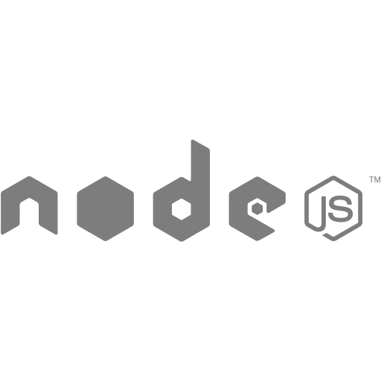
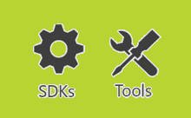
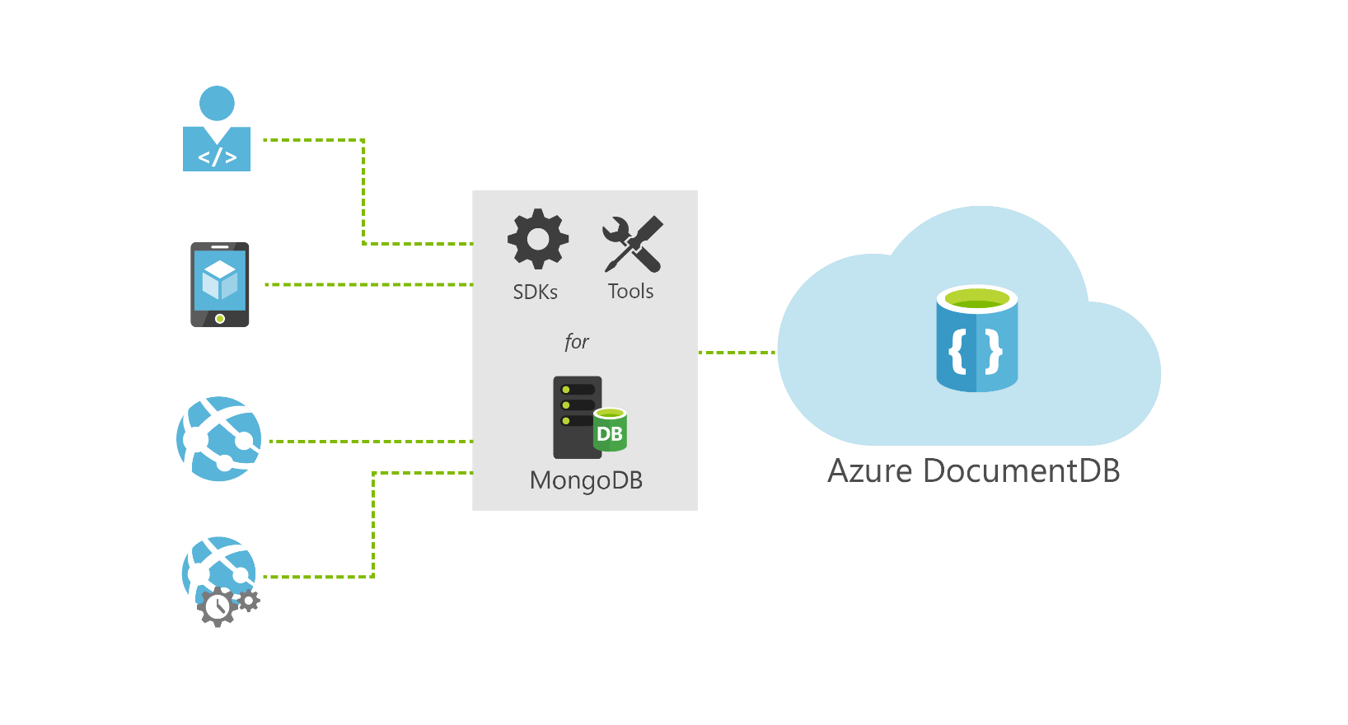



DocumentDB: Tools, SDKs and protocol support for MongoDB
Ruby
MongoDB wire protocol
…
Java
.NET
drivers for MongoDB
REST over HTTPS/TCP
Java
.NET
DocumentDB

Slide 33
Demo
Visual Studio and Azure
Notes:
Azure and Visual Studio - 20 min - Mikkel
Easy repeatable provisioning of resources - Infrastructure as Code
Show ARM tooling
Get from VS to the Cloud in sub zero seconds…
Publish website to Azure (website and DB without the NPM)
Interact with the cloud without leaving VS
Azure resource interaction from Cloud Explorer
Easy repeatable build, test and deployment - CI/CD pipeline
VSTS git, build and release
Test is release x
Production is release x-1
Release to production

Slide 34
Announcing Azure Command-Line Interface (CLI) 2.0 Preview
A new native Posix/BASH based Commandline experience
Available at GitHub in preview mode – looking for early feedback and engagement with adopters
Current xplat CLI will continue to be available and supported – will be needed for ASM services
Both CLIs work side-by-side in the same command shell window

Slide 35
Node.js + Azure

Slide 36
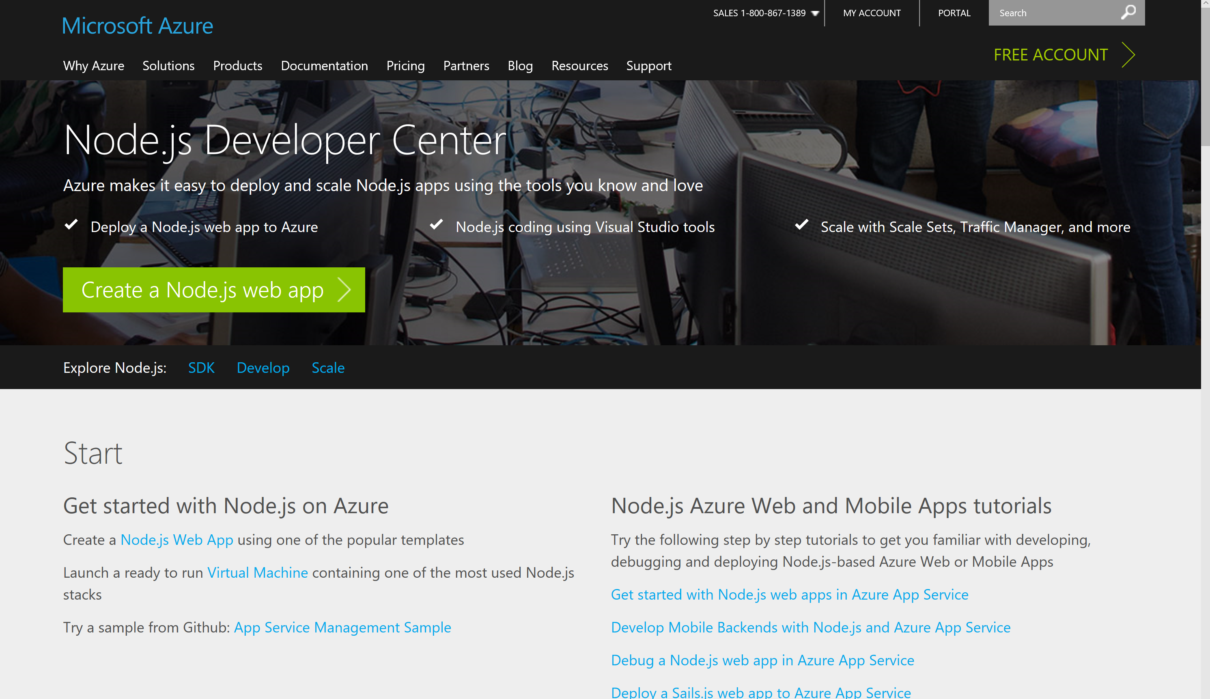
Node Dev Center – azure.com/node

Slide 37
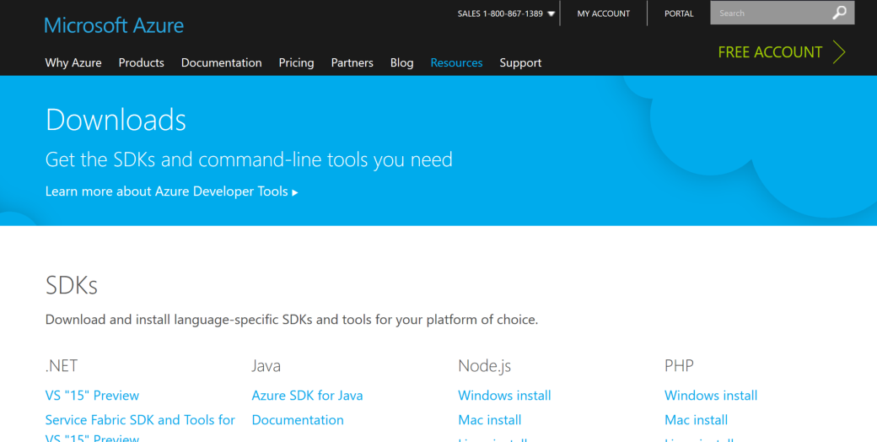
azure.microsoft.com/downloads/

Slide 38
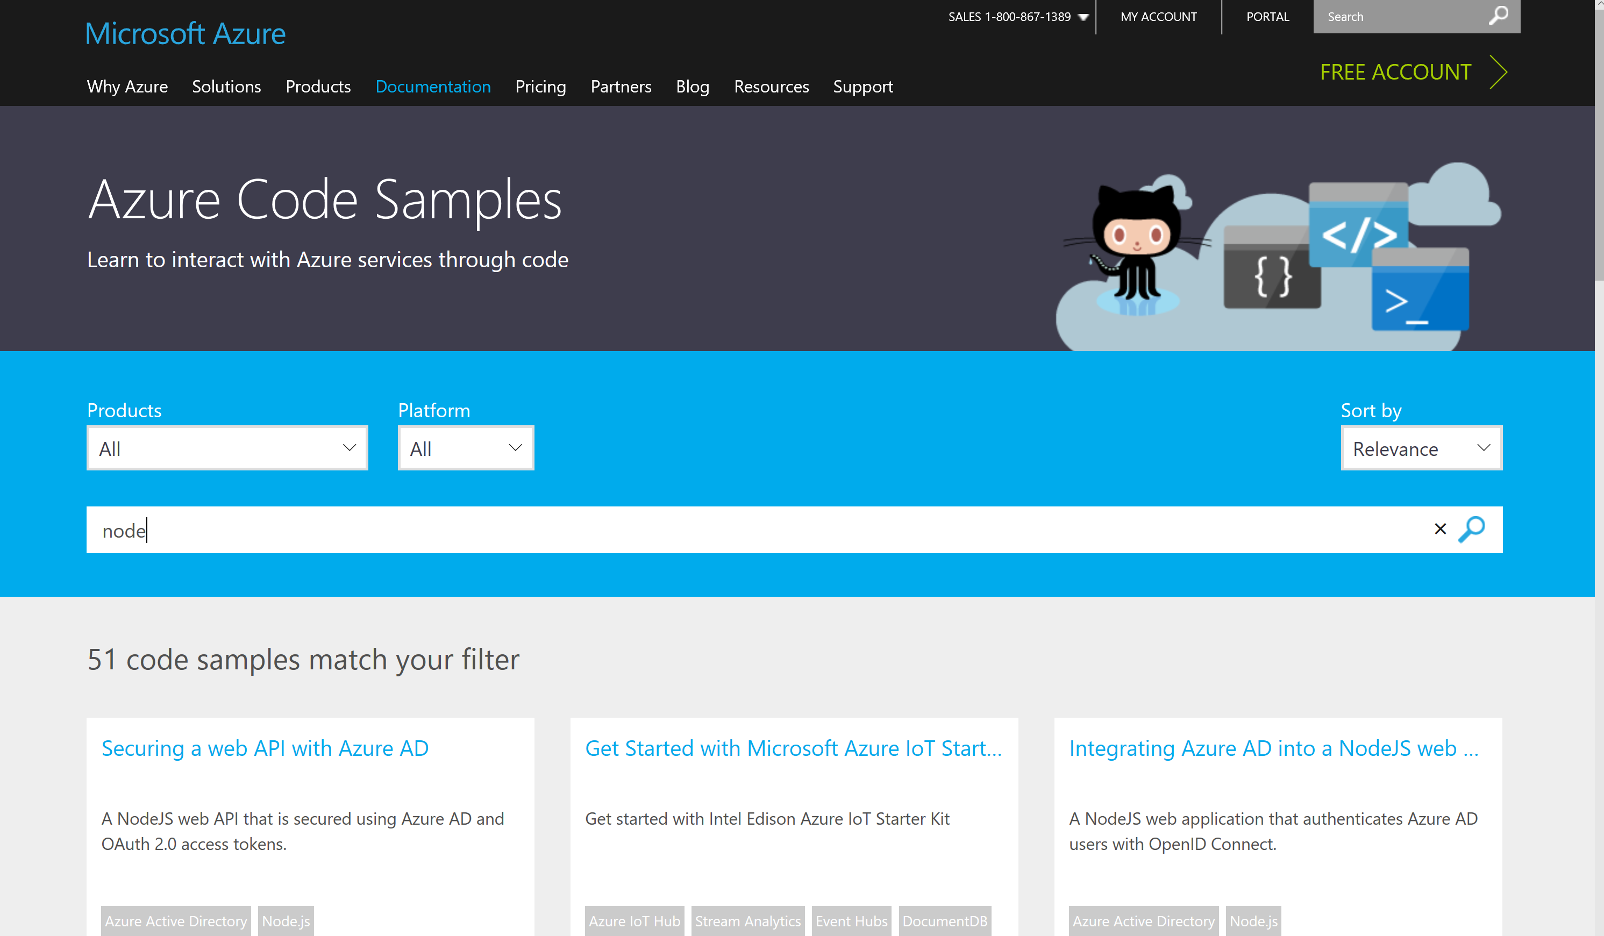
Node.js Code Samples

Slide 39
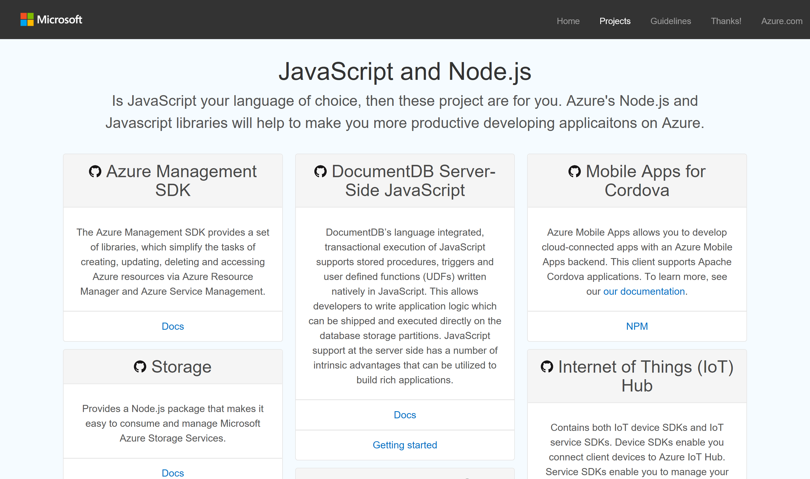
azure.github.com

Slide 40
SDKs for Node
Storage
Active Directory
Full developer ecosystems in Azure for your deployment needs and beyond
Key Vault
ApplicationInsights
Resource Manager
DocumentDB
SQL Database
SQL Azure
Web Apps
Data Lake
Cognitive Services Coming Soon !!!
Media Services
Management
Scheduler
Service Bus
Notification Hubs

Slide 41
Demo
Azure Command-Line Interface (CLI) 2.0 Preview
Notes:
Azure CLI - 20 min - Kamal
CLI Announcement
Get started and personalize
Install, config, account
Be productive
VMlist
Query with grep
Get easy insights
Website log tail

Slide 42
Developer Benefits

Slide 43

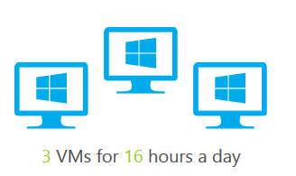


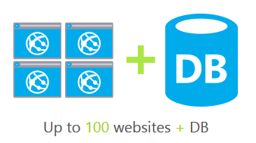
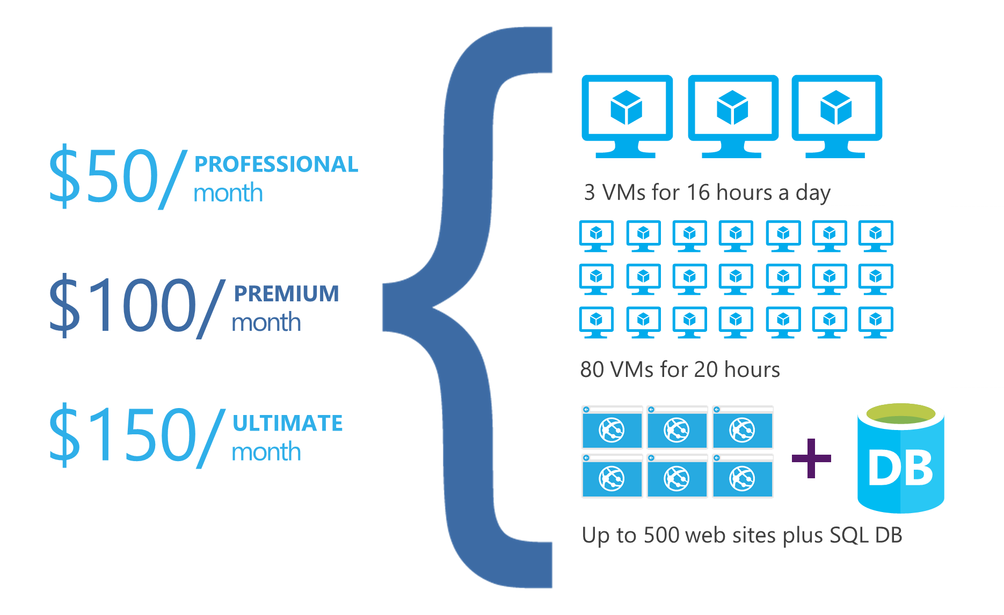
DEV ESSENTIALS
Microsoft Azure benefits
$25/month
Visual Studio Dev Essentials (free)
Not a Visual Studio subscriber? Get a $25 monthly Azure credit by joining Visual Studio Dev Essentials
3 VMs for 8 hours a day
40 VMs for 20 hour load test
25 HDInsight nodes for 10 hours
Up to 50 websites + DB
Visual Studio subscription (paid, MPN, or BizSpark)
Try out different Azure services, experiment, and learn
Provision developer machines with Visual Studio VMs in Azure
Great for individual dev/test workloads
Each Visual Studio subscriber gets up to $150 per month to use for dev/test in Azure
No charge for software installed for dev and test, plus access to subscriber-only VM gallery and special dev/test rates on HDInsight, Web Apps, and Cloud Service instances
PROFESSIONAL/TEST PROFESSIONAL
$50/month
MSDN PLATFORMS
$100/month
ENTERPRISE
$150/month
Notes:
Talking Points
Visual Studio Dev Essentials provides a fully-customizable experience, adaptable to the new developer needs of learning and adopting new technologies, choosing the most suitable solution for the problem on hand and enables a highly productive build, measure and learn dev/test/production lifecycle. You can get a $25 monthly Azure credit by joining Visual Studio Dev Essentials for free. For more information on Visual Studio Dev Essentials: https://www.visualstudio.com/en-us/products/visual-studio-dev-essentials-vs.aspx
Visual Studio subscription: When you purchase a Visual Studio subscription (formerly called MSDN subscriptions) you get a variety benefits from software, services, training and developer accounts for submitting apps to the store. The monthly Azure credit for Visual Studio subscribers provides an easy, low-risk, low-friction path for cloud adoption. If you already have a Visual Studio subscription, activate your Azure benefits and start building cloud apps today. For more information on monthly Azure credits for Visual Studio subscribers, visit: https://azure.microsoft.com/en-us/pricing/member-offers/msdn-benefits-details/

Slide 44
Developer Resources
Preview Pricing
https://www.microsoft.com/cognitive-services/en-us/pricing
Deploy for Production
https://portal.azure.com/#create/Microsoft.CognitiveServices/
Documentation
https://www.microsoft.com/cognitive-services/en-us/computer-vision-api/documentation
Client SDKs
https://aka.ms/cognitivesdks
Join Our Community
https://stackoverflow.com/questions/tagged/microsoft-cognitive
https://social.msdn.microsoft.com/forums/azure/en-US/home?forum=mlapi
https://cognitive.uservoice.com/

Slide 45
Tools
Office 365 Developer Site
That’s where files will be stored so that’s obvious
Set up a development environment for SharePoint Add-ins on Office 365: https://msdn.microsoft.com/en-us/library/office/fp179924.aspx#o365_signup
Windows Azure
This is going to be used for authentication to Office 365
Azure trial: https://azure.microsoft.com/en-us/pricing/free-trial/
Visual Studio and Xamarin
This is what we’re going to be using to build Android app with C# and .NET

Slide 46
Office Platform
Engage
Join the Office 365 Developer Program - http://dev.office.com
Follow us on Twitter - @OfficeDev
Code in our upcoming hackathon - http://hackproductivity.devpost.com
Provide feedback at User Voice - https://officespdev.uservoice.com
Interact on Stack Overflow - office-js, microsoftgraph, office365api, office365connectors, excel-addins, outlook-web-addins, sharepoint-api

Slide 47
Getting Started Now
Developer portals
dev.onedrive.com
dev.office.com
OneDrive on GitHub
Samples and demos are available today
All the demos from this session are available on GitHub right now.
Use the SDKs
Graph SDKs are coming soon.
OneDrive SDK is available for .NET, iOS, Android, and Python.
These provide authentication, service discovery, and easy-of-use for the REST API on these platforms.

Slide 48
Questions?

Slide 51

Vision
From faces to feelings, allow your apps to understand images and video
Microsoft Cognitive Services
Give your apps a human side
Speech
Hear and speak to your users by filtering noise, identifying speakers, and understanding intent
Language
Process text and learn how to recognize what users want
Knowledge
Tap into rich knowledge amassed from the web, academia, or your own data
Search
Access billions of web pages, images, videos, and news with the power of Bing APIs

Slide 52
Cognitive Services: 0-60

Slide 53
Vision
Computer Vision API
Face API
Emotion API
Video API
Distill actionable information from images
Detect, identify, analyze, organize, and tag faces in photos
Personalize experiences with emotion recognition
Analyze, edit, and process videos within your app

Slide 54
Vision APIs: Getting Started

Slide 55
Speech
Vision
Bing Speech API
Speaker Recognition API
Custom Recognition Intelligent Service
Convert speech to text and back again, and understand its intent
Give your app the ability to know who's talking
Fine-tune speech recognition for anyone, anywhere

Slide 56




Speech
Language
Bing Spell Check API
Web Language Model API
Linguistic Analysis API
Language Understanding Intelligent Service (LUIS)
Text Analytics API
Detect and correct spelling mistakes within your app
Leverage the power of language models trained on web-scale data
Easily parse complex text with language analysis
Teach your apps to understand commands from your users
Detect sentiment, key phrases, topics, and language from your text

Slide 57




Introducing Language Understanding Intelligence Service (LUIS)
A Microsoft Cognitive Service that provides developers with an easy way to create language models to allow applications to understand user commands.
Train by providing examples
Create your own LU model
Deploy to an HTTP endpoint and activate on any device
Maintain model with ease

Slide 58
Text Analytics and LUIS

Slide 59

Language
Knowledge
Academic Knowledge API
Knowledge Exploration Service
Entity Linking Service
Recommendations API
Explore relationships among academic papers, journals, and authors
Add interactive search over structured data to your project
Contextually extend knowledge of people, locations, and events
Provide personalized product recommendations for your customers

Slide 60
Search
Knowledge
Bing Web Search API
Bing Autosuggest API
Bing Image Search API
Bing Video Search API
Bing News Search API
Connect powerful search to your apps
Give your app intelligent autosuggest options for searches
Bring advanced image and metadata search to your app
Trending videos, detailed metadata, and rich results
Link your users to robust and timely news searches

Slide 61
References
https://msdn.microsoft.com/en-us/skype/websdk/skypewebsdk
https://msdn.microsoft.com/en-us/skype/appsdk/skypeappsdk
http://developer.skype.com
A Technical Deep Dive into Building Web Apps with the Skype Web SDK (Ignite 2015)
Engage and Win Users with Your Apps Through Intelligent Conversations (Build 2016)
Relation Sessions
Drive real-world success with Skype for Business platform solutions https://myignite.microsoft.com/sessions/2631
Dive deep on the new Trusted Application API for Skype for Business Online https://myignite.microsoft.com/sessions/2629
Build native cloud apps for Skype for Business: Skype Developer platform overview
https://myignite.microsoft.com/sessions/2630

Slide 62
Additional resources
https://graph.microsoft.io
https://github.com/OneDrive
https://dev.onedrive.com
https://github.com/MicrosoftGraph
https://onedrive.uservoice.com
http://stackoverflow.com/questions/tagged/onedrive

